Slide 1

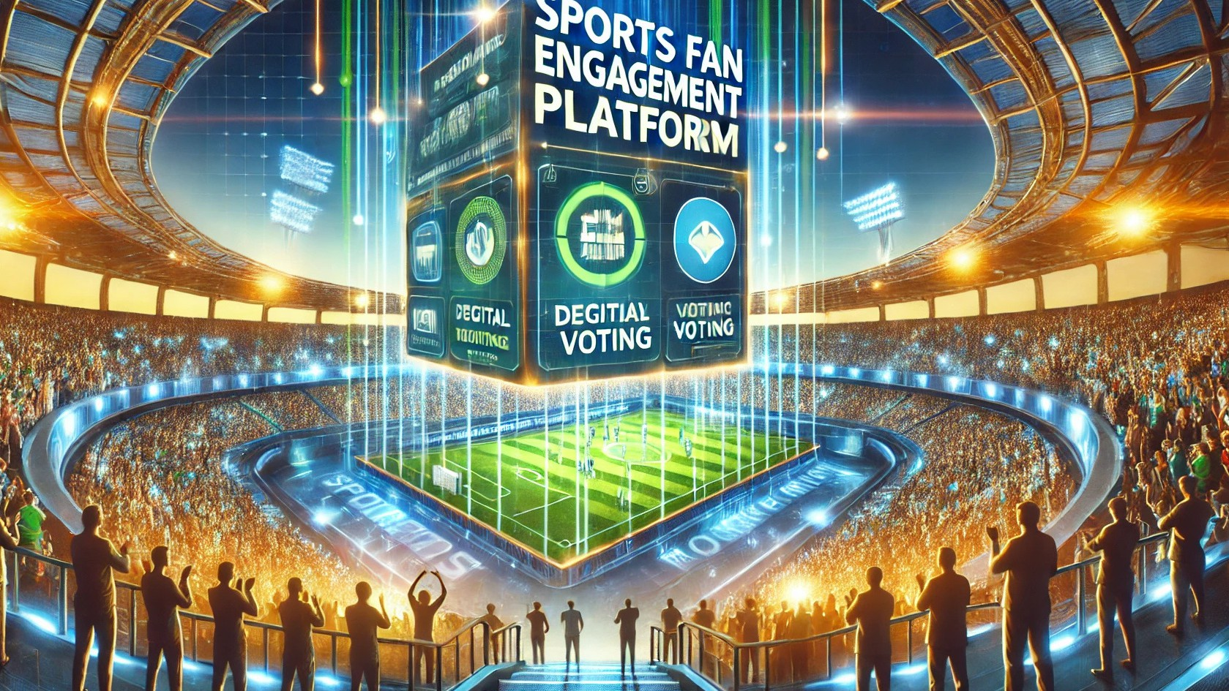


SPORTS FAN ENGAGEMENT PLATFORM
By S.Lakshana(22EC046)

Slide 2

Why This Project?
Fans are disconnected from their teams, limited to watching games on TV or social media with no direct interaction. They want exclusive content, deeper engagement, and ways to connect with teams and players. Sports teams aren’t fully using digital platforms to monetize fan engagement, missing revenue opportunities. Fans navigate multiple platforms for updates, tickets, and merchandise, leading to a fragmented experience. With the rise of mobile, social media, and technologies like AR, VR, and AI, fans now expect more personalized, interactive experiences. There is a growing demand for immersive and tailored fan engagement.
Our Solution
Our sports fan engagement platform offers a unified space for fans to interact with teams, players, and fellow fans. It provides exclusive content, real-time updates, and personalized experiences. Fans can access live scores, behind-the-scenes footage, and special events. The platform also allows teams to monetize engagement through in-app purchases and premium content. Fans can enjoy a seamless experience across mobile, web, and social media. By integrating technologies like AR, VR, and AI, we create immersive and interactive fan experiences.

Slide 3

Abstract
01.
Content updates,
Delivery: Provide real-time exclusive content, and
personalized experiences to keep fans engaged.
The Sports Fan Engagement Platform is an innovative digital solution aimed at enhancing fan interaction
and loyalty by providing a dynamic, immersive
experience. It leverages real-time data, exclusive content, gamification, and interactive features to foster deeper connections between fans and their
favorite teams or athletes. By offering live updates,
personalized experiences, and community-driven activities, the platform creates a unique space for
fans to engage, interact, and share in the excitement
of sports, ultimately strengthening fan communities and driving long-term brand loyalty.
02.
Fan Interaction: Enable direct interaction
through features
live chats, polls, and social to foster community
engagement.
03.
Monetization: Generate revenue through in-app purchases, subscriptions, fan tokens, and premium content offerings.

Slide 4
Introduction
The Sports Fan Engagement Platform is a cutting-edge
digital solution designed to revolutionize how fans interact with their favorite sports teams, athletes, and events. In an age where fan loyalty and participation are crucial, this
platform provides a unique space for fans to connect,
engage, and immerse themselves in the sports they love.
With features such as real-time updates, exclusive content, live chats, gamification, and personalized experiences, the platform empowers fans to be more than just spectators— they become active participants in the sports ecosystem.
By fostering deeper connections and creating memorable
experiences, the Sports Fan Engagement Platform enhances fan loyalty, strengthens community ties, and drives long-
term brand growth for teams and organizations.

Slide 5
Display Rankings
public void displayRankings(Map<String, Entity> map, String type) {
System.out.println("\n" + type + " Rankings:"); map.values().stream()
.sorted((e1, e2) -> Integer.compare(e2.votes, e1.votes))
.forEach(System.out::println);
}
Most Voted Entity
public void displayMostVoted(Map<String, Entity> map, String type) {
Entity mostVoted = map.values().stream()
.max(Comparator.comparingInt(e -> e.votes))
.orElse(null);
if (mostVoted != null) {
System.out.println("\nMost Voted " + type + ": " + mostVoted);
} else {
System.out.println("No votes yet.");
}
}

Slide 6


Timed polling system
public void startTimedPoll(int seconds) {
long startTime = System.currentTimeMillis(); Scanner scanner = new Scanner(System.in);
while (System.currentTimeMillis() - startTime < seconds * 1000) {
System.out.println("\n1. Vote for Player\n2. Vote for Team\n3. Vote
for Event");
System.out.println("4. Show Player Rankings\n5. Show Team Rankings\n6. Show Event Rankings");
int choice = scanner.nextInt(); scanner.nextLine();
if (choice == 1) vote(players, scanner.nextLine(), getUsername(scanner));
else if (choice == 2) vote(teams, scanner.nextLine(), getUsername(scanner));
else if (choice == 3) vote(events, scanner.nextLine(), getUsername(scanner));
else if (choice == 4) displayRankings(players, "Player"); else if (choice == 5) displayRankings(teams, "Team"); else if (choice == 6) displayRankings(events, "Event");
else System.out.println("Invalid option! Try again.");
}
System.out.println("Voting time is up!");
}

Slide 7
1. Real-Time Voting System
✅ Fans can vote for players, teams, and events
✅ Votes are counted and updated
instantly
✅ Ensures an interactive and dynamic experience
4. Live Rankings & Leaderboards 📊
✅ Fans can view rankings of players, teams, and events
✅ Automatically sorts and displays top- voted choices
✅ Highlights the most popular entities
Key Features
2. Fair & Transparent Voting
✅ Prevents duplicate voting by tracking user votes
✅ Users can only vote once per entity to ensure fairness
✅ Maintains vote integrity and credibility
5.User-Friendly & Interactive Interface 🎮
✅ Simple menu-based voting system
✅ Allows users to vote and check rankings easily
✅ Can be extended to mobile or web applications
6.. Scalable & Customizable
✅ Can add new categories (e.g., coaches, matches, etc.)
✅ Expandable for other sports or entertainment events
✅ Can integrate with social media or analytics tools
3. Timed Polling Mode ⏳
✅ Admins can set a fixed voting duration
✅ Creates a sense of urgency & excitement
✅ Automatically closes voting after the set time

Slide 8


Main method(execution)
public static void main(String[] args) {
SportsFanEngagementPlatform platform = new SportsFanEngagementPlatform();
Scanner scanner = new Scanner(System.in);
platform.addEntity(platform.players, "Virat Kohli", "Batsman");
platform.addEntity(platform.players, "MS Dhoni", "Wicketkeeper"); platform.addEntity(platform.teams, "Mumbai Indians", "IPL Team");
platform.addEntity(platform.teams, "Chennai Super Kings", "IPL Team"); platform.addEntity(platform.events, "IPL Final", "Event");
platform.startTimedPoll(30);
platform.interactivePoll(scanner);
}
Creates platform instance
Pre-loads players, teams & events Runs timed & interactive polls

Slide 9
Data Structures and Algorithms used in this project
Data Structures Used
🔹 HashMap (Map<K, V>)
🔹 HashSet (Set<K>) Algorithms Used
🔹 Sorting Algorithm – Stream.sorted() (Comparing Votes for Rankings)
🔹 Maximum Finding Algorithm – Stream.max() (Finding Most Voted Entity)
🔹 Searching Algorithm – HashMap Lookup (map.get(entityName))
Additional Concepts
🔹 Timed Polling Mechanism (Time-Based Condition)
🔹 User Interaction & Input Handling

Slide 10
Future Enhancements
Advanced Voting Mechanisms Data Storage & Persistence
UI/UX Improvements
AI & Analytics Integration
Performance & Optimization Gamification & Rewards
Social Media & Community Engagement Security Enhancements
Possible Enhancements
✅ Replace HashMap with TreeMap to keep entities sorted automatically.
✅ Use a Priority Queue (Heap) for faster rankings (O(log N) retrieval).
✅ Implement Database Storage for persistent voting records.

Slide 11
Thank yoou

